Slide 1
Unity Spatial Partitioning Presentation.
Jeremy Zoitas

Slide 2

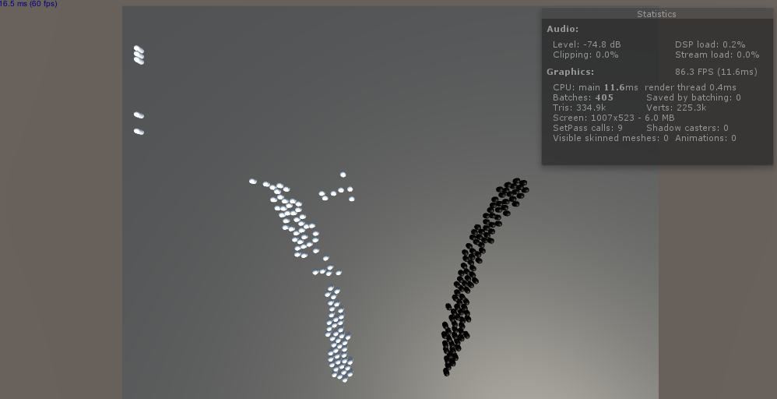
Overview.
The program tests different Spatial Partitioning techniques against each other in Unity, for example it tests the naive approach to a k-dtree.
Has a group of AI that walk into each other and looks for the closest opposite color.
The frames per second are being displayed to determine the performance difference and the data will be used in excel documents.

Slide 3
Technical Information.
Has four scripts AI_Move, Find closest, UI Stats, k-dtree.
AI_Move moves the Agents around the scene.
Find Closest uses the k-dtree data structure to find the closest enemies of the opposite team.
K-dtree which creates the data structure and can add, remove, find closest, etc.

Slide 4
Hypothesis.
Using k-dtrees will be increase the frame rate rather than the checking everything against themselves.
Checking everything against themselves will work ok until a point and then will drastically decrease performance.
The spawning of the AI will be slow and may smooth out once they are all spawned.

Slide 5
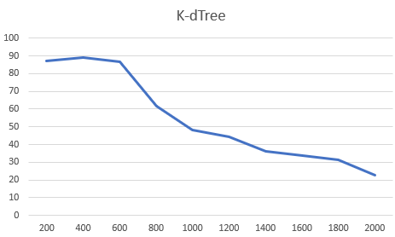
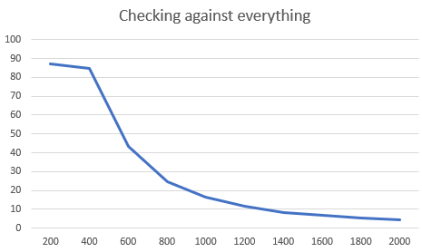
Results.

Slide 6
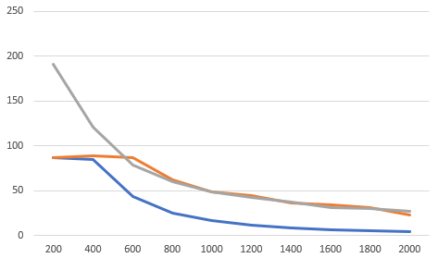
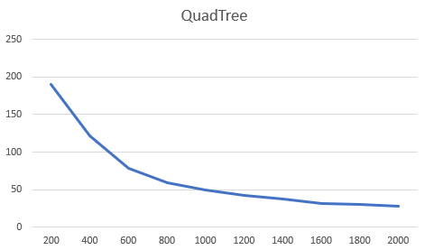
Results.

Slide 7
What worked well.
The planning of the project went smoothly with the research proposal being created to a high standard.
The scope of the project was not set to large which meant there was some time other assignments.
There was a lot of information about this topic.
It was easy to see the difference between the techniques in the project and was easy to adjust.

Slide 8
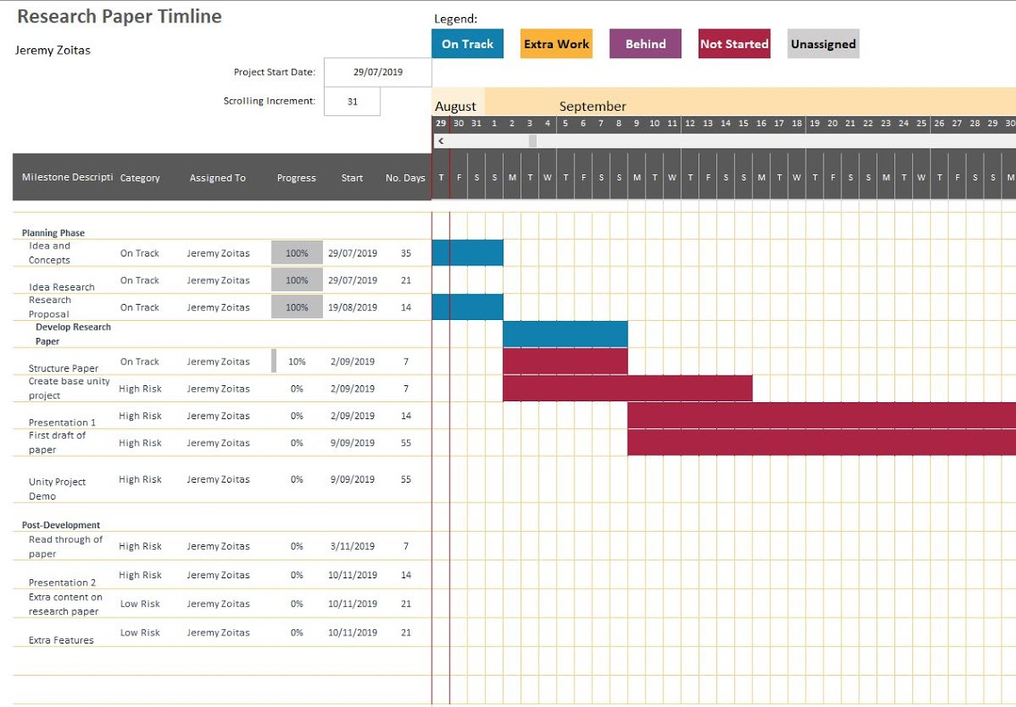
What did not work.
Underestimated the amount work needed for some of the techniques.
Projects schedule was not followed as planned earlier in the year.
Hard to find good tutorials to help in creating the techniques in Unity.

Slide 9
Areas of improvement.
The project could have more techniques to test to get a better understanding of what works more efficiently.
The project time management was poorly executed.
Getting more data than just frames per second as well as how well it works on different computers.

Slide 10
Conclusion/ Future work
That using k-dtrees helps improve the performance by around seven times amount than checking everything.
The findings could be used to help improve games such as RTS games by splitting the AI into subdivisions.
Future features could include: - Different scenarios obstacles in the middle when they meet. - Use crowd simulation on collision to increase the power of the program. - Switch between methods in runtime to see the effect of each scenario. - Have a UI that lets the user add more AI, change method, add obstacles, display stats, etc.

